Slide 1
Deciphering the DJ Basin
A machine learning-driven analysis
and comparison with the Permian
SPE Denver General Meeting
15-November, 2023

Slide 2
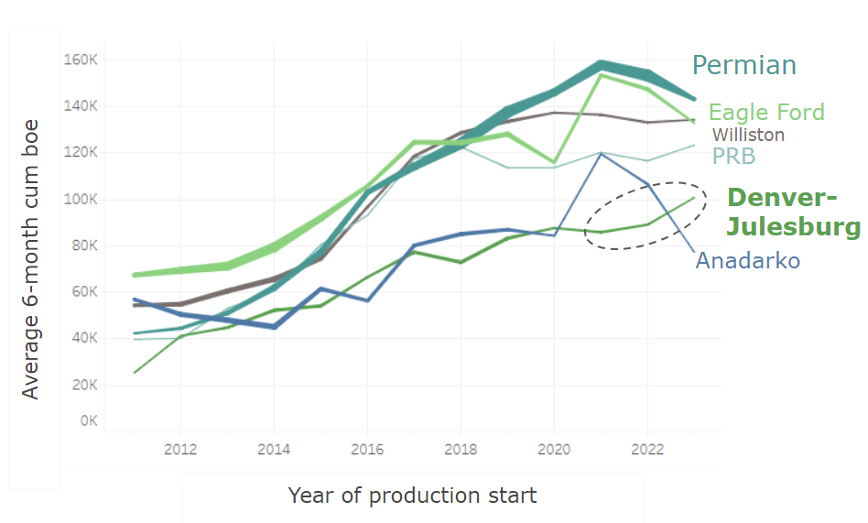
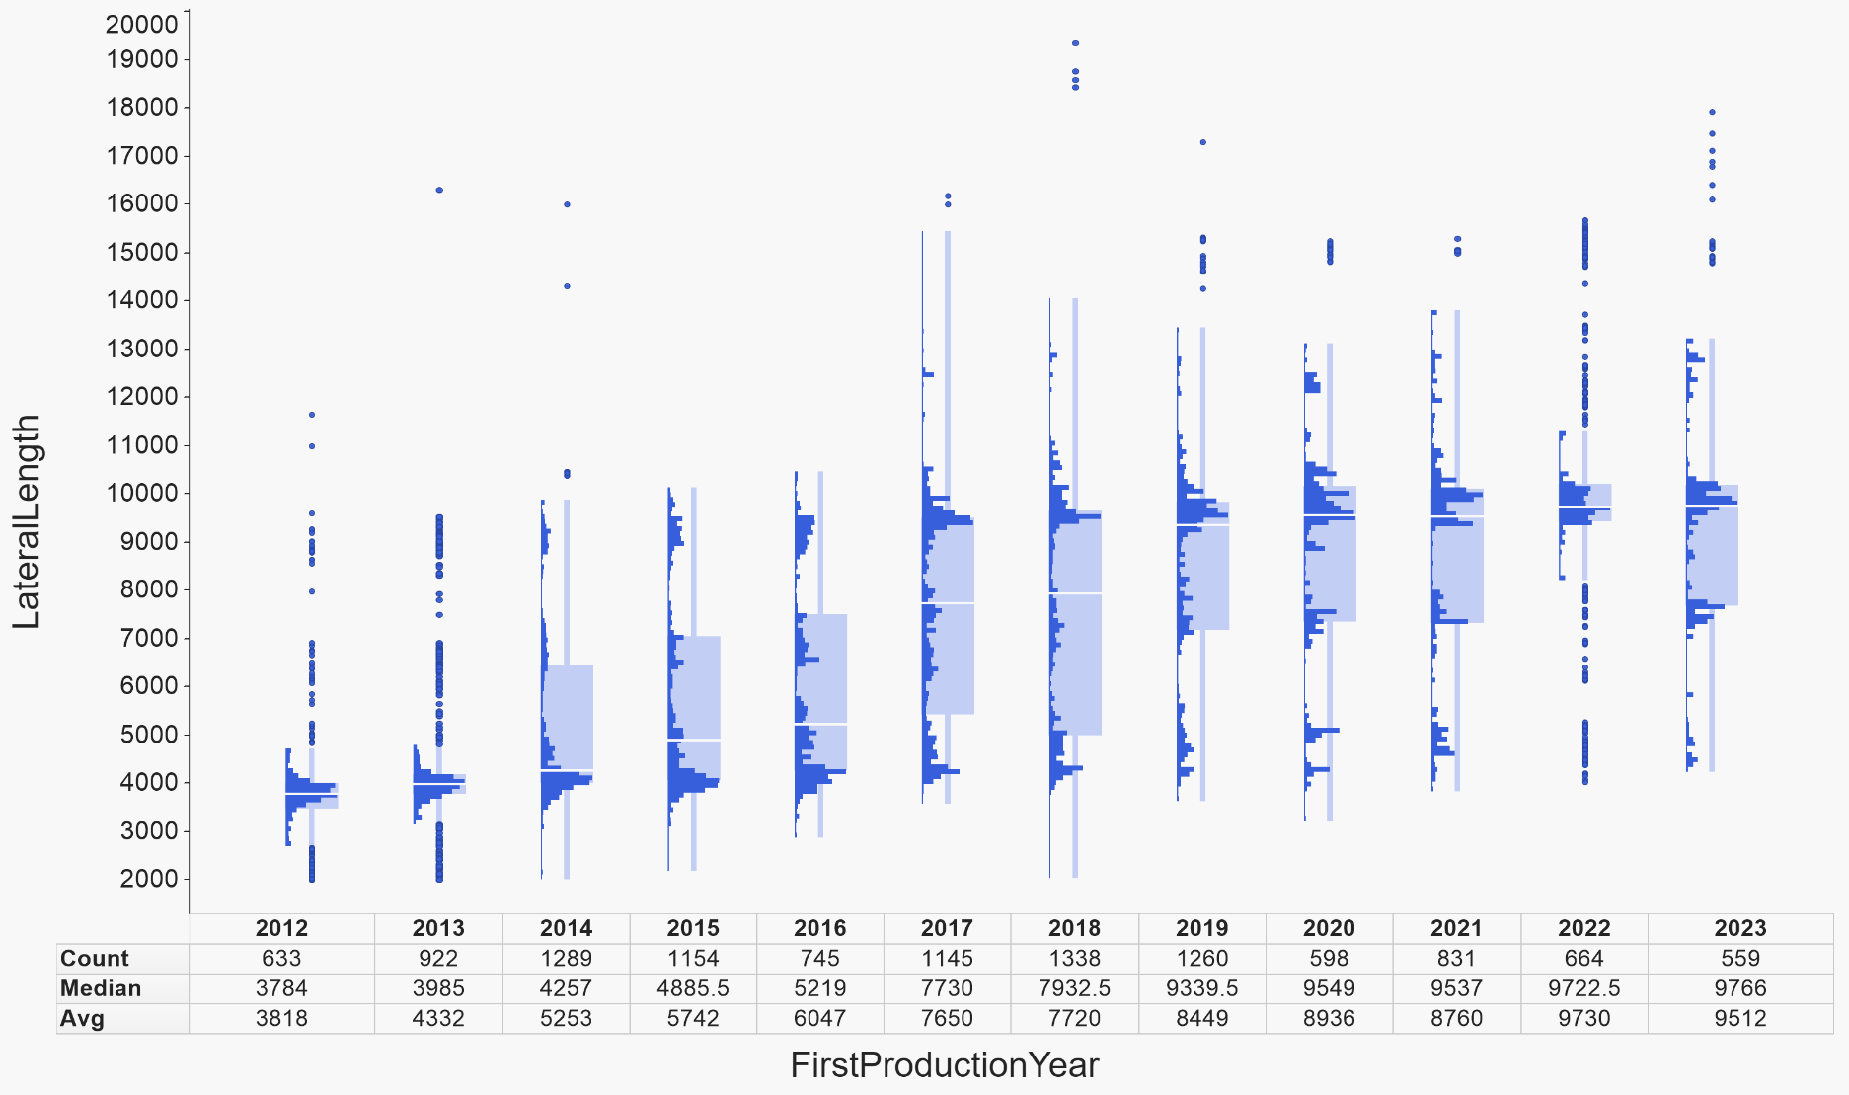
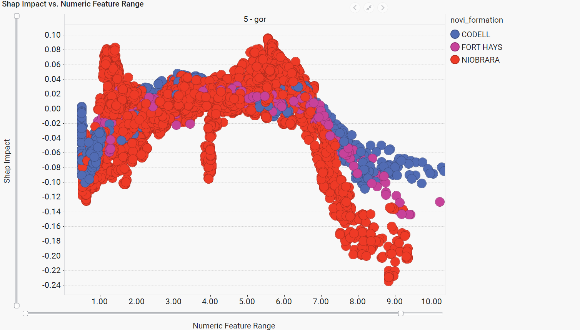
TODAY’S ANALYSIS - DJ BASIN
1) Review of production/performance trends in the DJ Basin & comparison to other plays
2) Examination of design & activity trends during “consolidation phase”
3) Machine learning-based analysis of performance drivers and comparison with the Permian

Slide 3
PRODUCTION & PERFORMANCE TRENDS

Slide 4
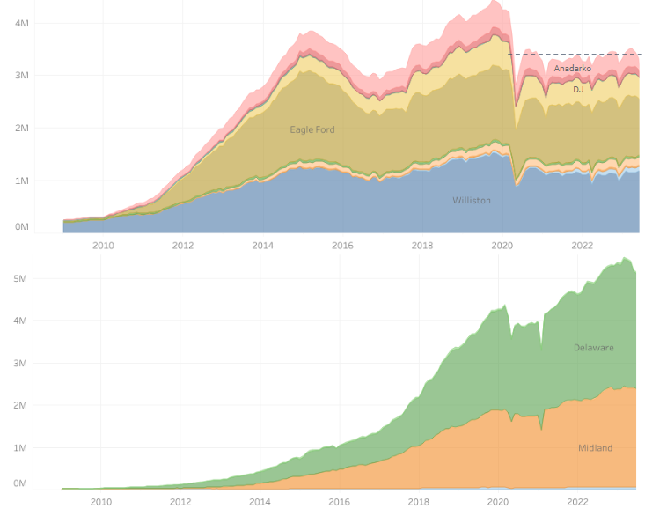
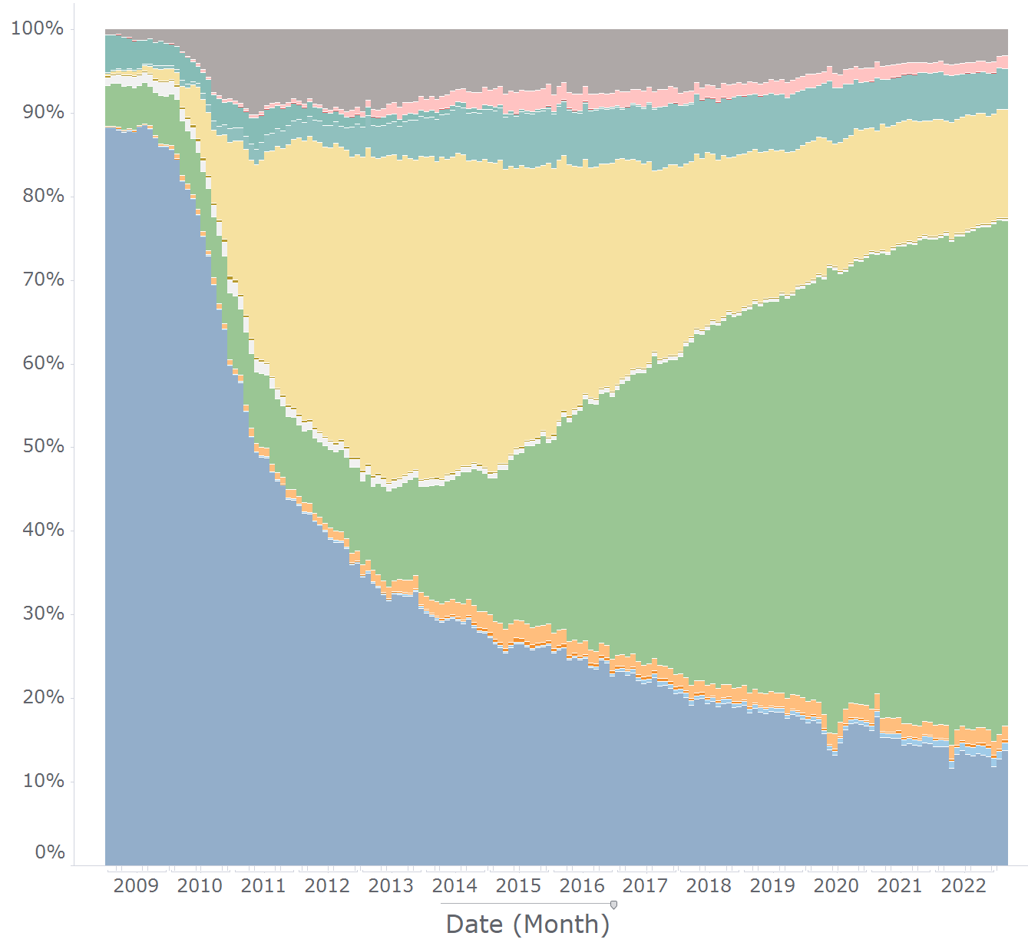
CONTEXT - L48 PRODUCTION
Non-Permian plays have similar trend over time
DJ producing similar fraction vs. other plays ex-Permian
Anadarko
Appalachia
DJ
Total production (bbl/d, hz)
Eagle Ford
Permian showing strong growth vs. pre-COVID
Fraction of L48 Hz Oil Production by Basin
Permian
Bakken
Powder River

Slide 5
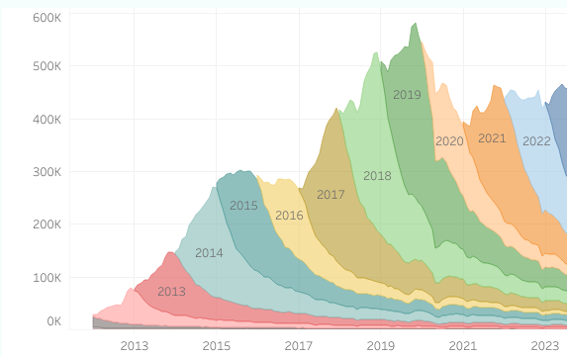
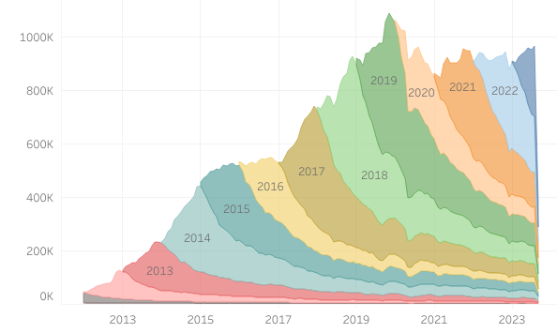
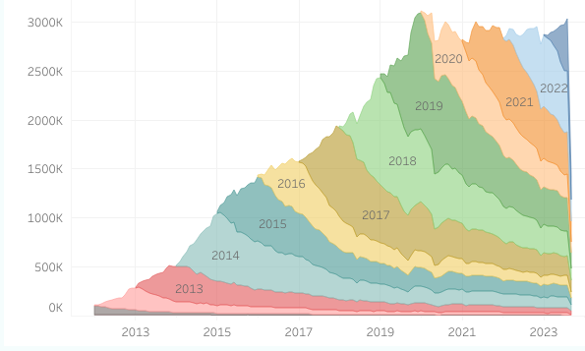
DJ BASIN - HORIZONTAL OIL AND GAS PRODUCTION
Oil production larger drop since 2019
Oil production (bbl/d, hz)
DJ production ~flat last 3 years
Total production (boe/d, hz)
Gas production near peak levels
Gas production (mcf/d, hz)

Slide 6
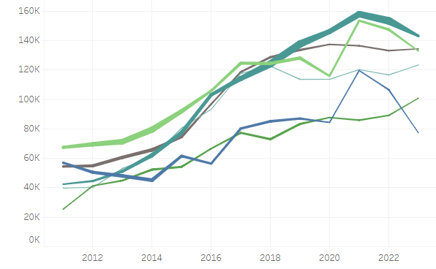
DJ BASIN PRODUCTIVITY GOING STRONG
Permian
Eagle Ford
Williston
PRB
Denver-
Julesburg
Average 6-month cum boe
Anadarko
Year of production start

Slide 7
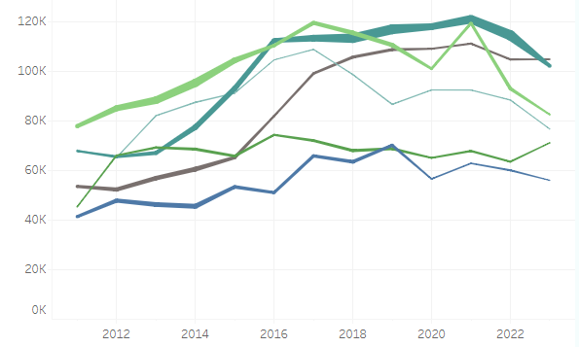
THIS HOLDS TRUE FOR LENGTH-NORMALIZED PRODUCTION TOO
Permian
Williston
PRB
Eagle Ford
Denver-
Julesburg
Average 6-month cum boe per 10k’
Anadarko
Year of production start

Slide 8
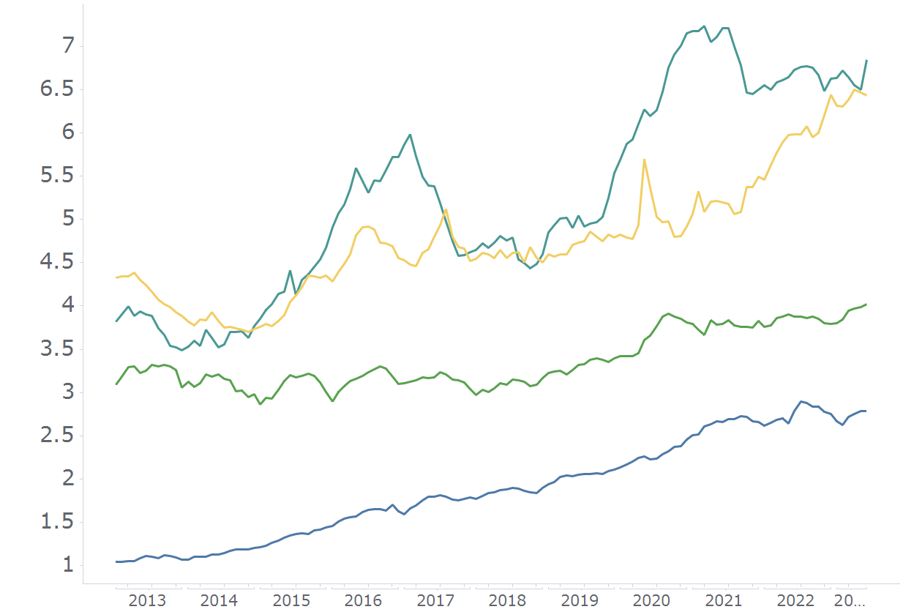
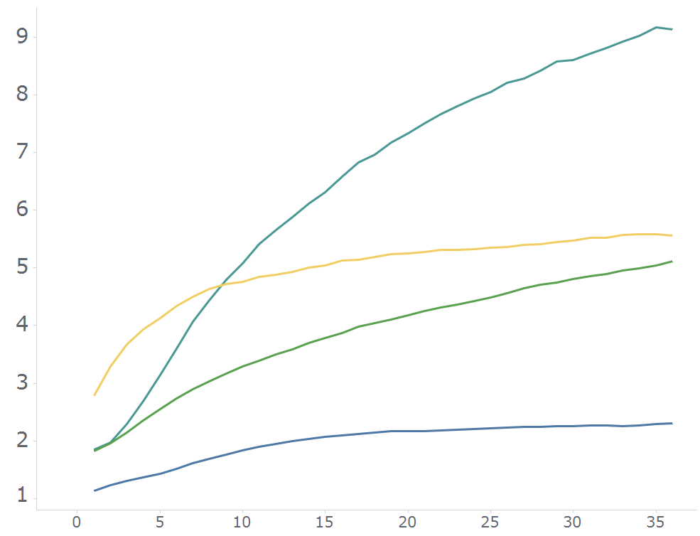
GOR TRENDS :: MAJOR UNCONVENTIONAL OIL PLAYS
DJ in aggregate has greater increase in GOR over time than other major unconventional plays
This is driven by large well age effect in DJ (2019 wells only)
DJ
DJ
Eagle Ford
Eagle Ford
Basin-wide gas-oil ratio (mcf/bbl), hz only
Permian
Average GOR (mcf/bbl)
Permian
Williston
Williston
Months on Production

Slide 9
CONSOLIDATION & DESIGN TRENDS

Slide 10
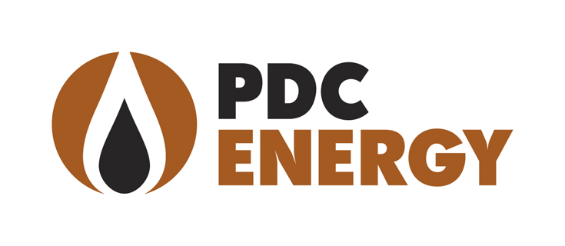
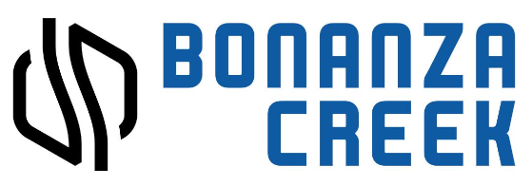
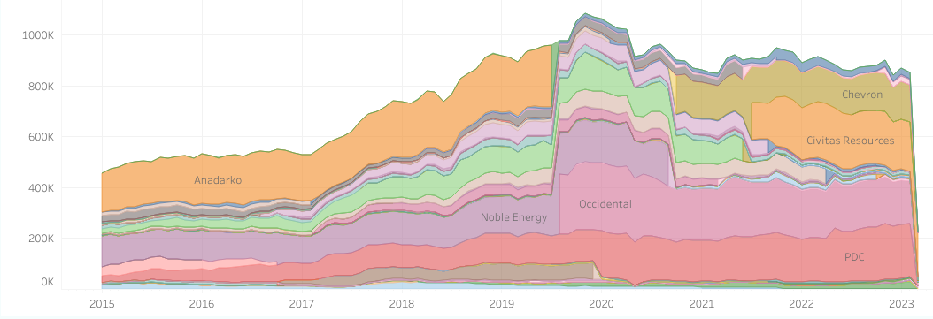
THE CONSOLIDATION OF A BASIN
“Consolidation phase” has been humming since 2020.
The DJ Basin is now dominated by Chevron, Civitas, and Oxy.
What does this mean for well designs, well performance, and production outlook?
PDC acquires SRC
Jan 2020
Bonanza Creek & XOG merge to form Civitas
Nov 2021
Chevron acquires PDC
May 2023
Oxy acquires Anadarko
Aug 2019
Chevron acquires Noble
Oct 2020
PDC acquires Great Western
May 2022
Daily hz oil production (boe/d) by Operator

Slide 11
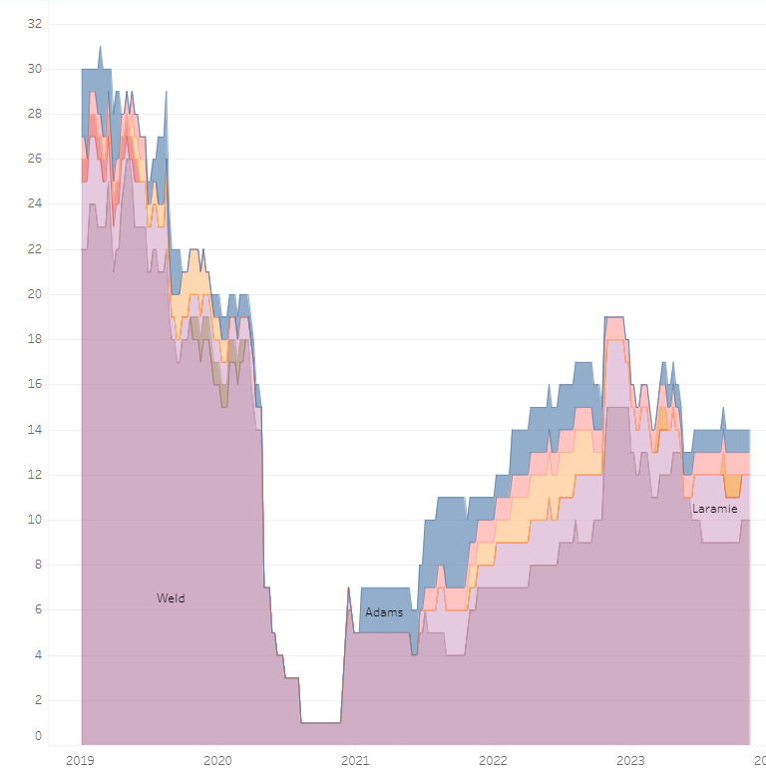
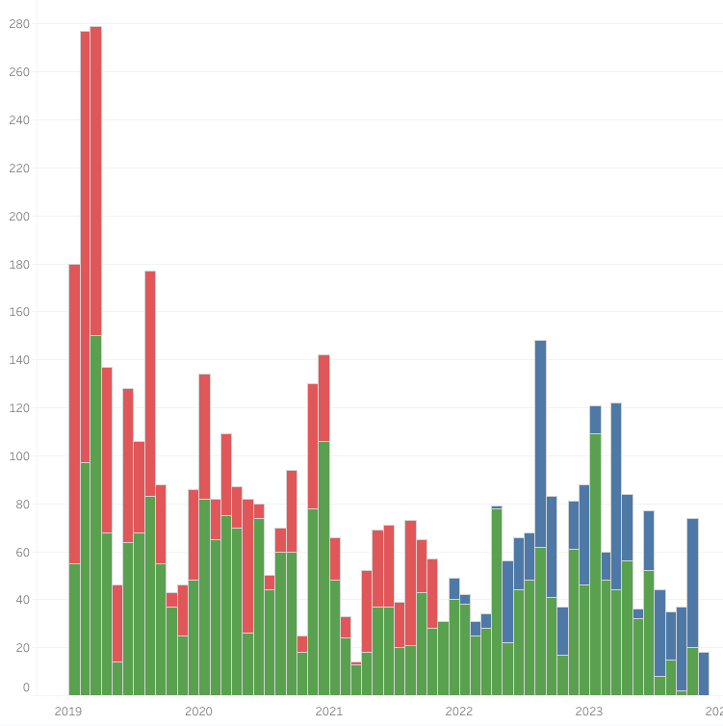
ACTIVITY - SINCE 2019
Consolidation Phase
Consolidation Phase
Hz Rig Count (Baker Hughes)
Permit Approvals

Slide 12
DESIGN TREND :: LATERAL LENGTH
Consolidation Phase

Slide 13
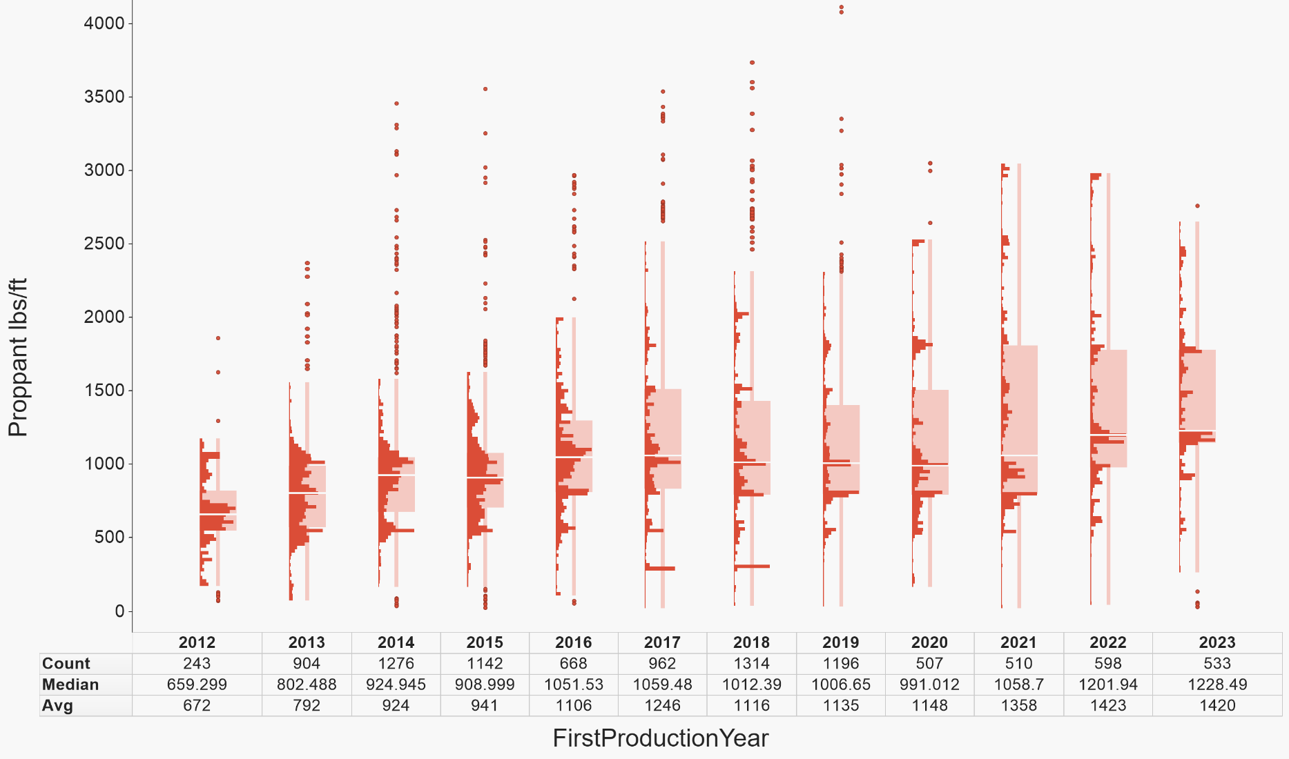
DESIGN TREND :: PROPPANT INTENSITY
Consolidation Phase

Slide 14
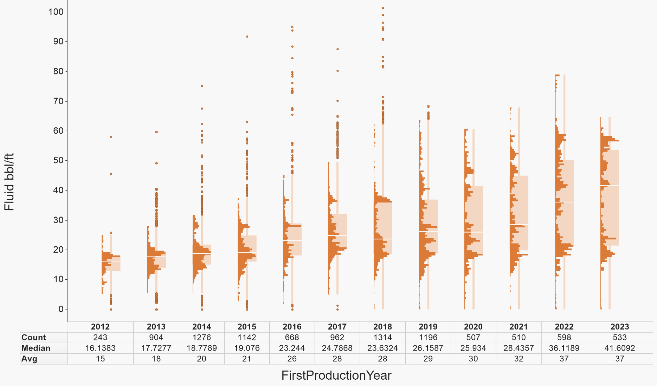
DESIGN TREND :: FLUID INTENSITY
Consolidation Phase

Slide 15
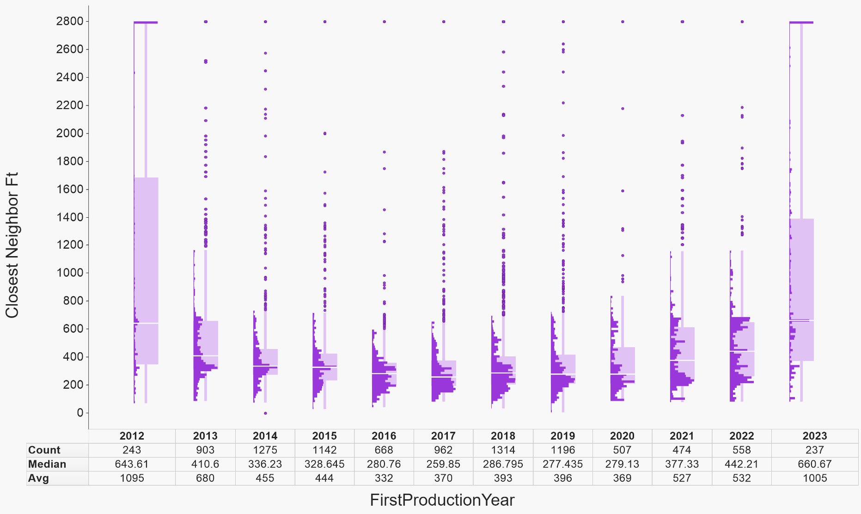
DESIGN TREND :: SPACING DISTANCE
Consolidation Phase

Slide 16
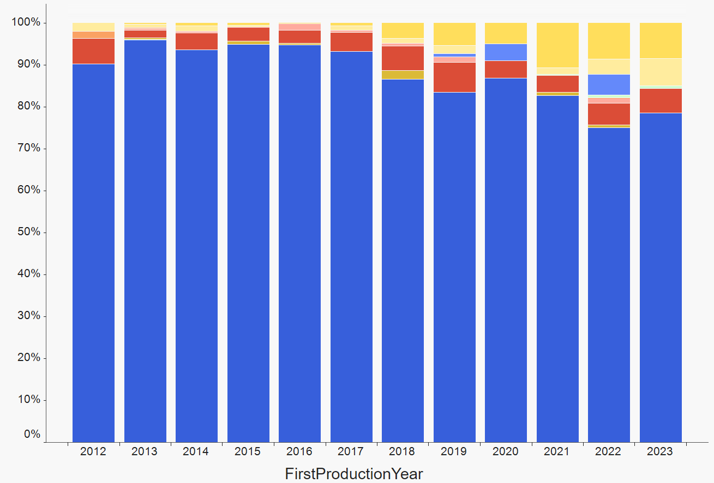
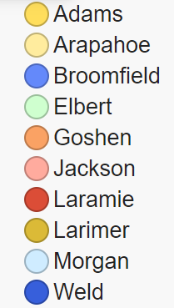
DEVELOPMENT TREND : AREA FOCUS
Consolidation Phase
Well Fraction

Slide 17
MACHINE LEARNING ANALYSIS

Slide 18
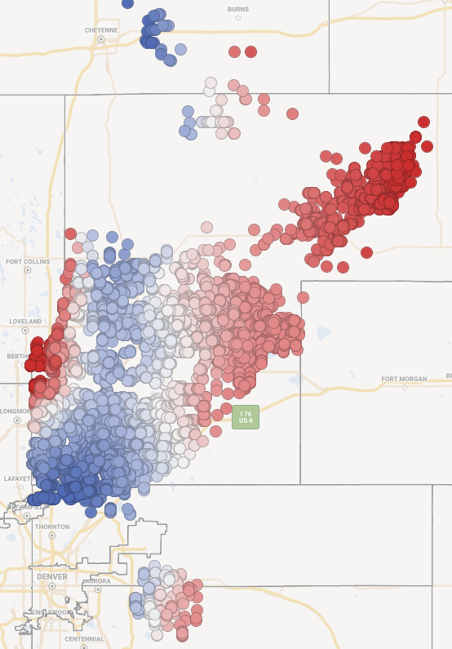
MACHINE LEARNING MODEL SETUP
Area:
Broader DJ Basin in CO & WY
Sources:
CO & WY oil and gas commissions, FracFocus
Input variables:
Completions - proppant/ft, fluid bbl/ft, stage spacing
Lateral Length
Spacing - average spacing of closest 6 neighbors, closest neighbor distances on either side, stacked neighbor distance
Timing - parent production life and distance
Geology - interpreted subsurface grids (TOC, Depth, Sw, Clay, Thickness, GOR)
Removed wells with significant missing data or non-modern designs, e.g. proppant <100 lbs/ft
NOT INCLUDED: operator, lat/long/county/area, clusters (not available publicly), fluid type (low quality publicly), post-drill operations (usually not available publicly)
Algorithm: decision-tree based w/ causal inference component (Novi proprietary)
Forecast: 3-year production profiles Oil, Gas, Water
Validation: 20% of pads randomly withheld for test set
Similar setup used for Midland Basin comparison model

Slide 19
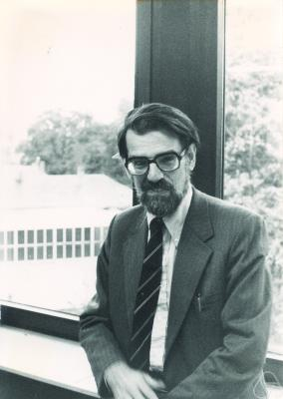
MODEL EXPLAINABILITY :: SHAP VALUES
Lloyd Shapley was an mathematician who was trying to answer this question:
If a bunch of people work on a group project together, how much credit should each one get?
He would later get an Economics Nobel Prize for this: "I consider myself a mathematician and the award is for economics. I never, never in my life took a course in economics."
This idea was adapted to machine learning models to determine the impact of an individual feature on a model prediction. This feature impact is known as SHAP (Shapley Additive Prediction)
https://github.com/slundberg/shap

Slide 20
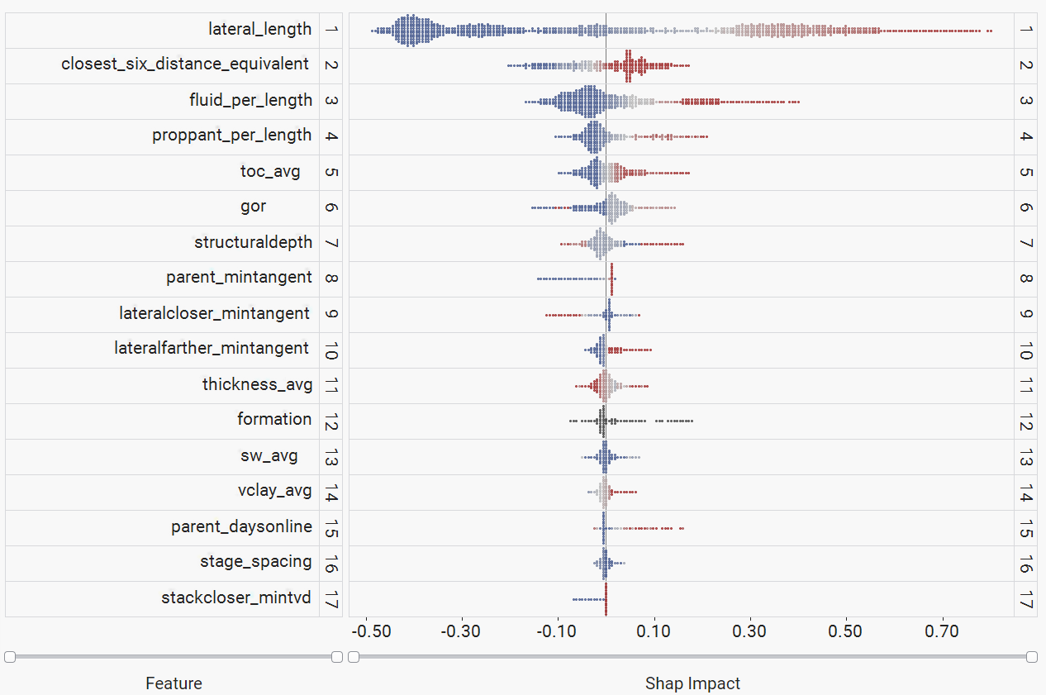
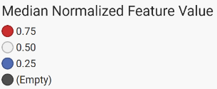
VARIABLE IMPORTANCE - DJ BASIN-WIDE OIL MODEL

Slide 21
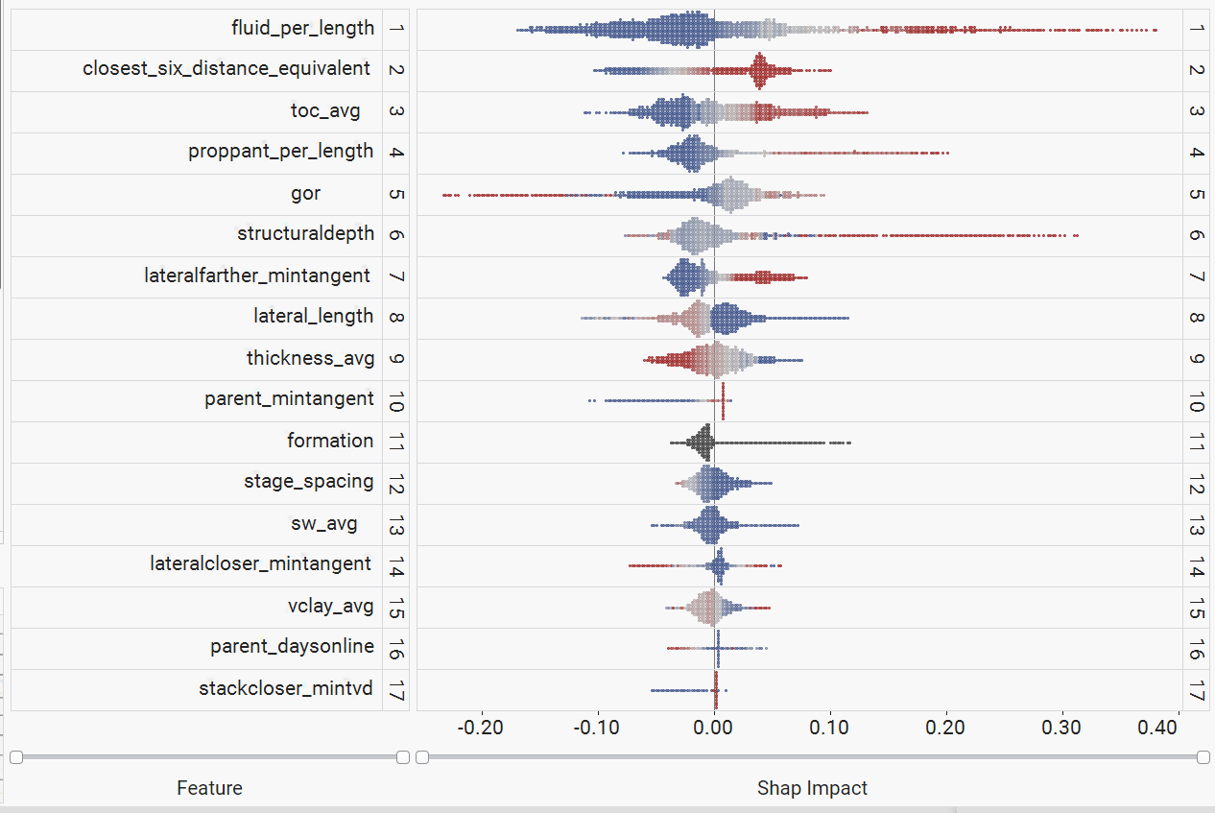
VARIABLE IMPORTANCE - DJ BASIN-WIDE OIL - LENGTH NORMALIZED

Slide 22
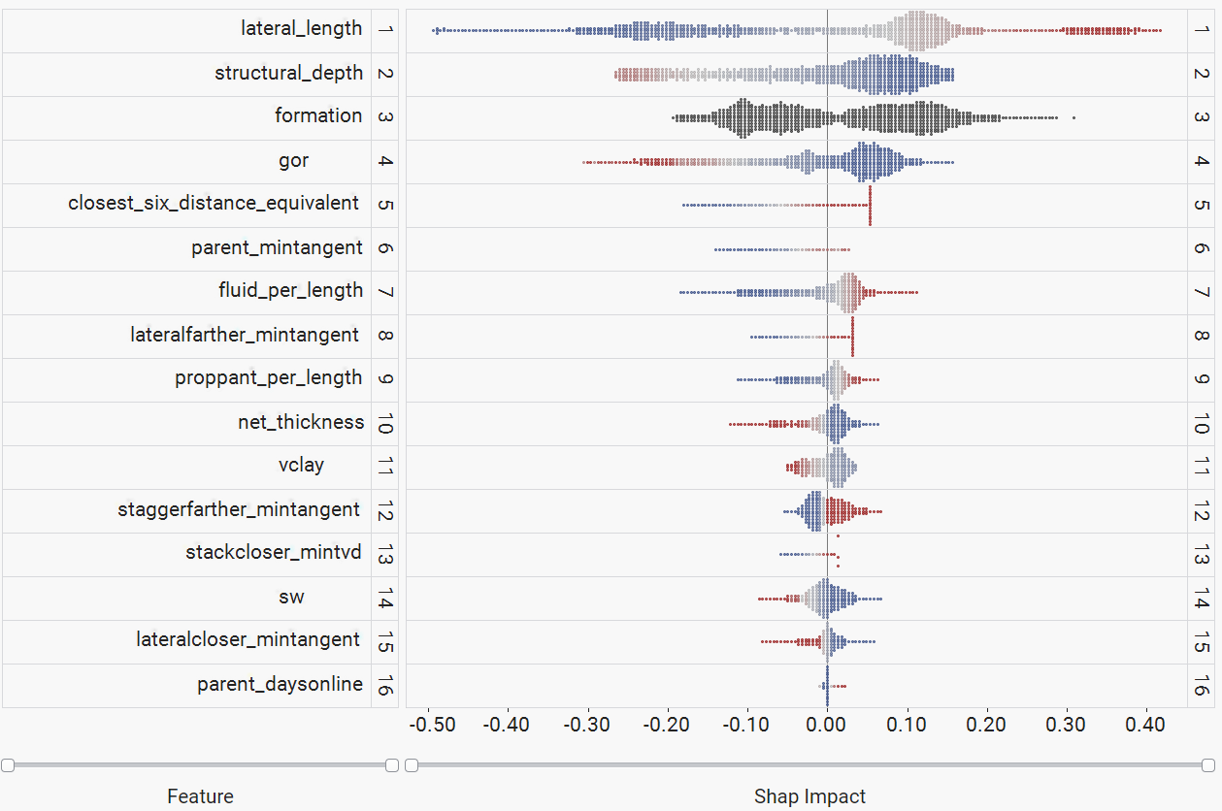
COMPARISON - DJ VS. MIDLAND
DJ
MIDLAND

Slide 23
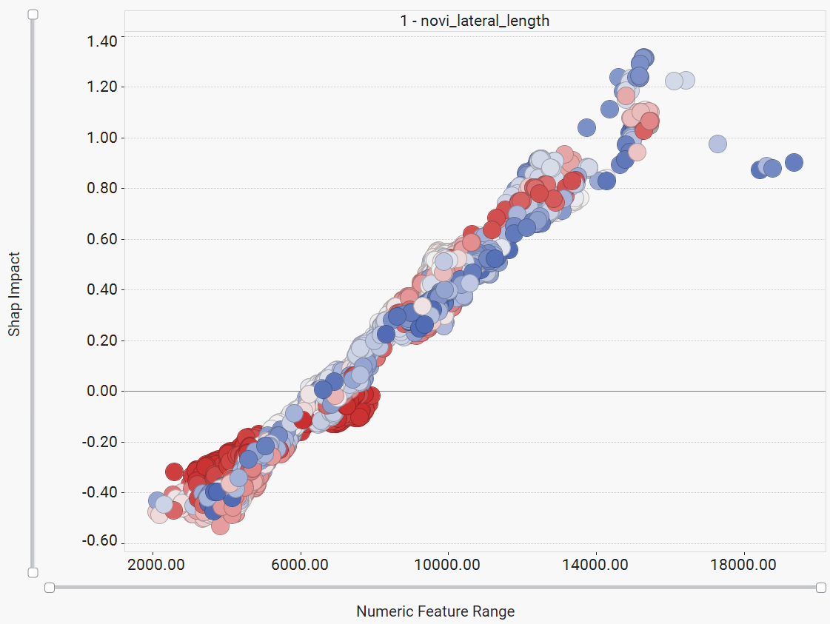
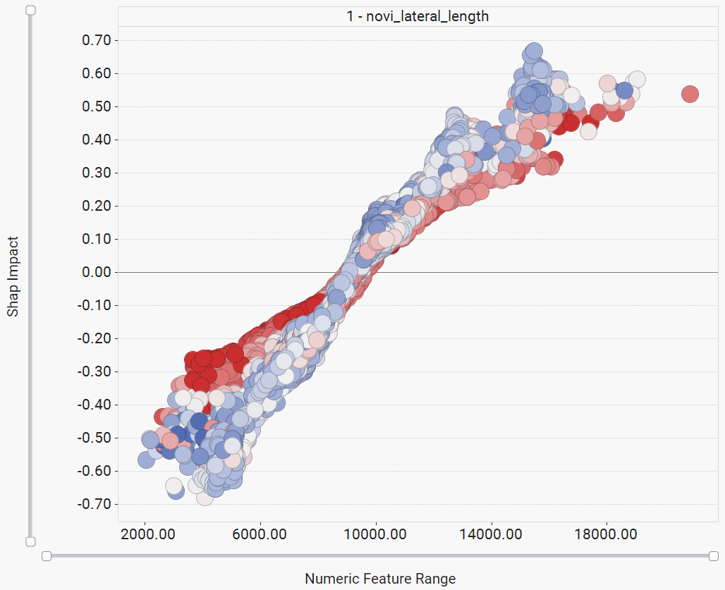
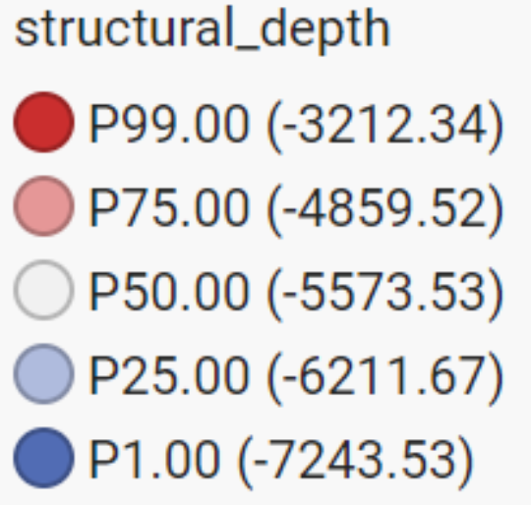
LATERAL LENGTH
DJ
MIDLAND
DJ
Structural Depth

Slide 24
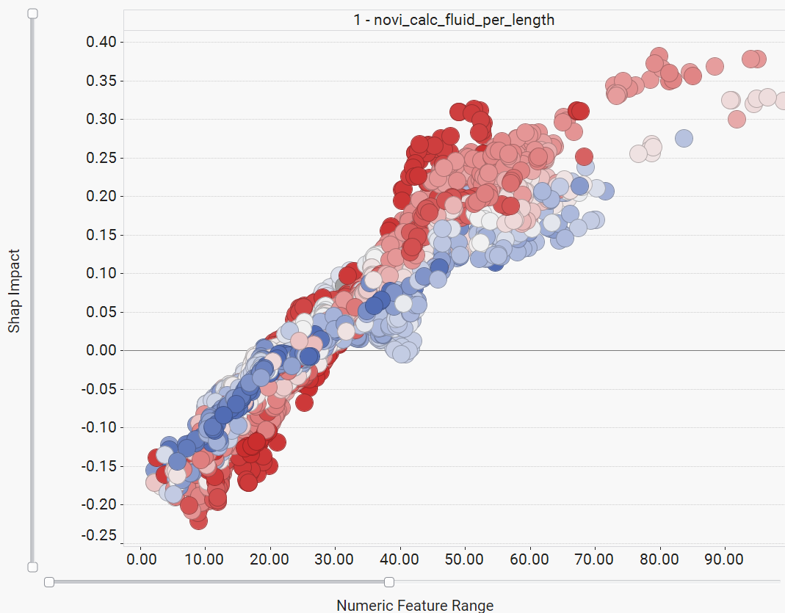
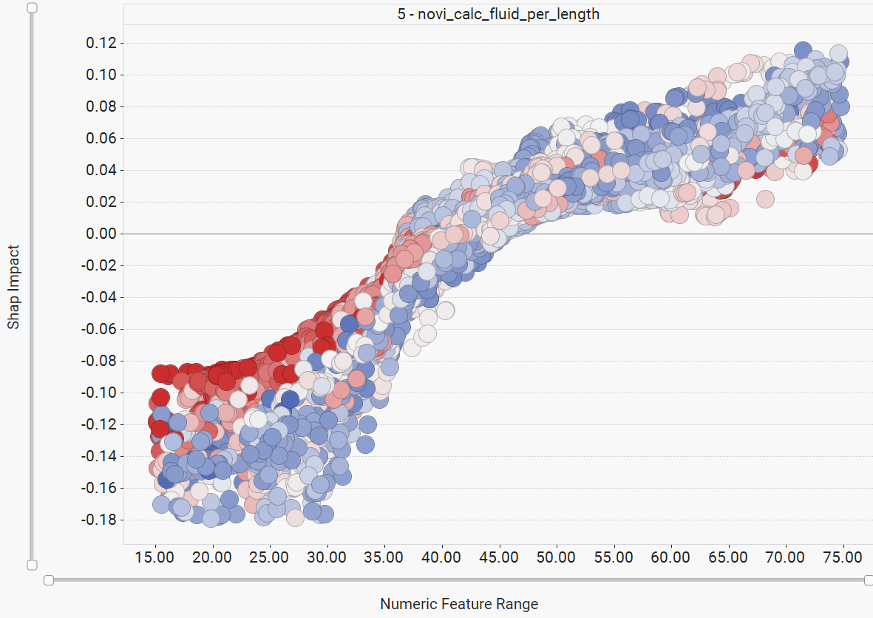
FLUID INTENSITY
DJ
MIDLAND
Structural Depth

Slide 25
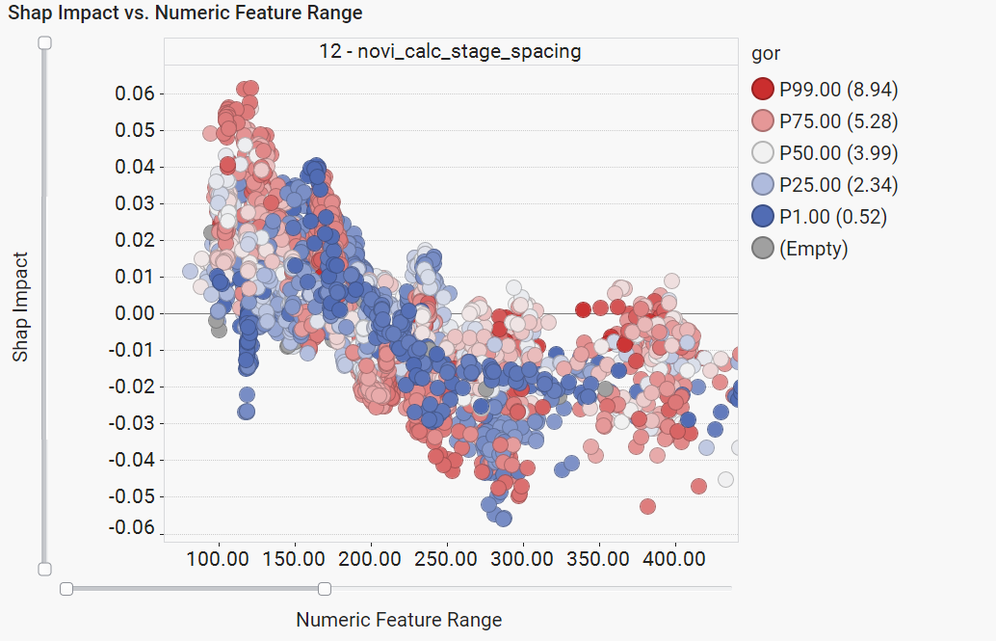
STAGE SPACING

Slide 26
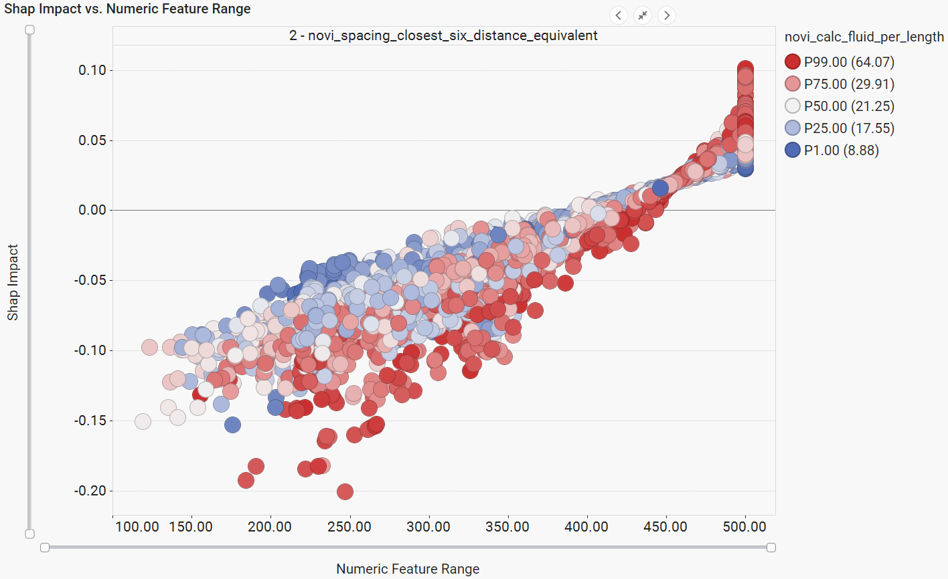
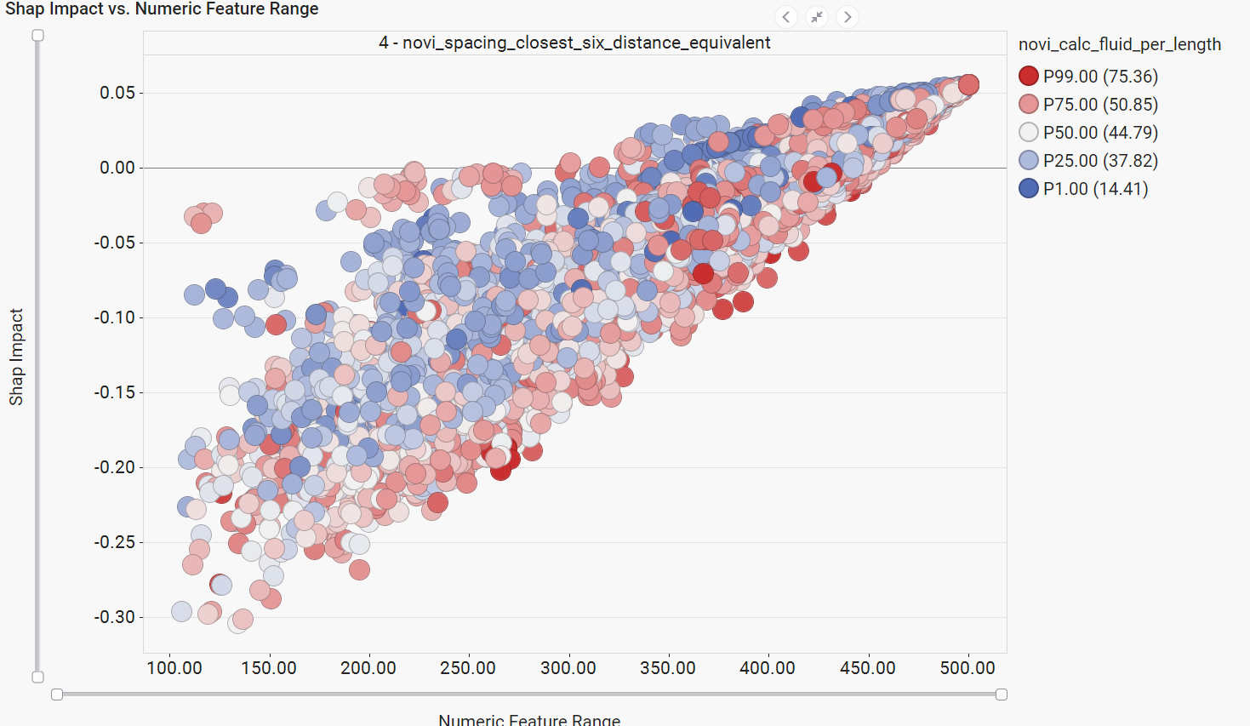
AVERAGE DISTANCE - CLOSEST 6 NEIGHBORS
DJ
MIDLAND

Slide 27
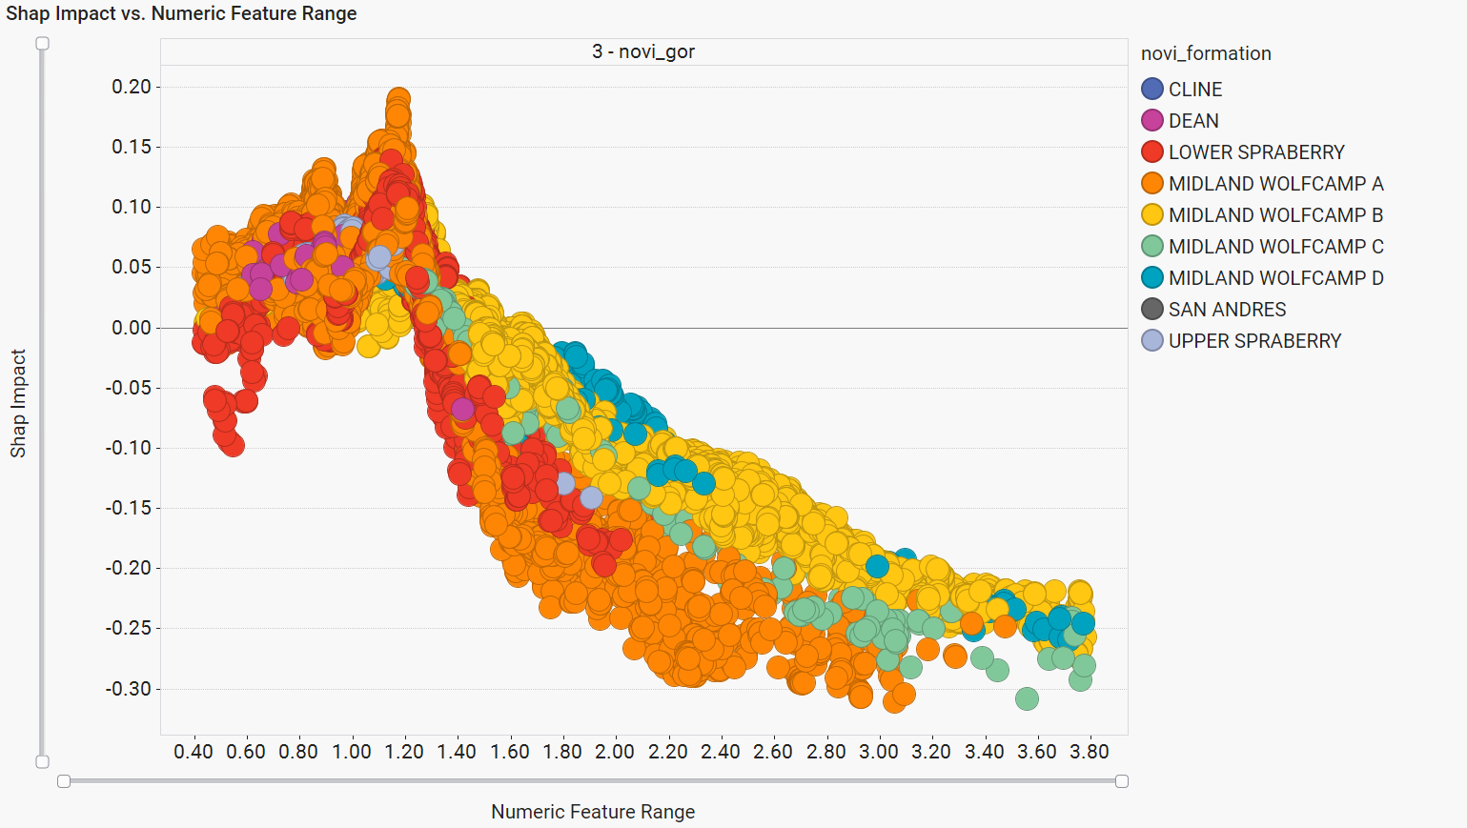
GOR
DJ
MIDLAND

Slide 28
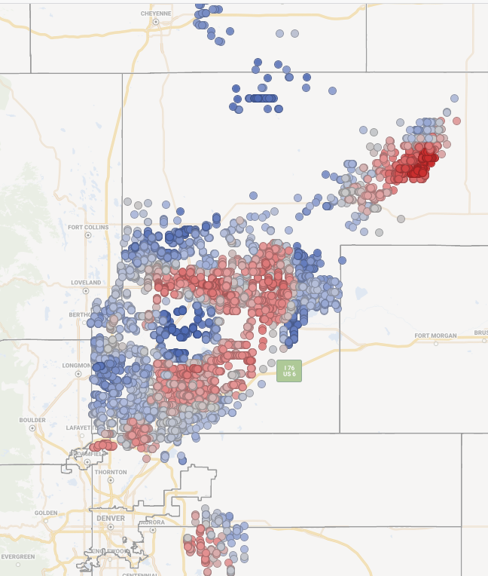
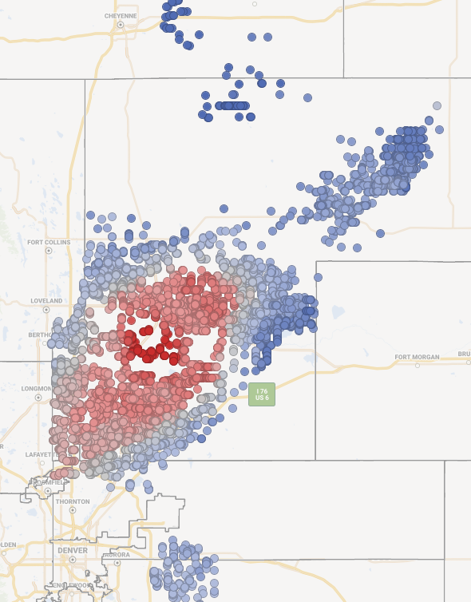
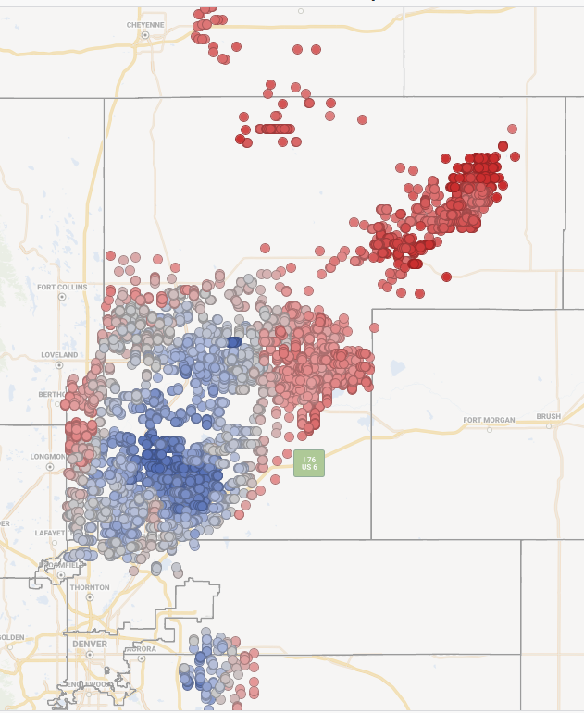
TOTAL GEOSHAP - DJ BASIN
Using the model outputs to understand total rock tendency to produce oil, water, and gas, independent of completions design & spacing/stacking
Oil
Gas
Water
More oil
More gas
More
water
Less oil
Less gas
Less water

Slide 29
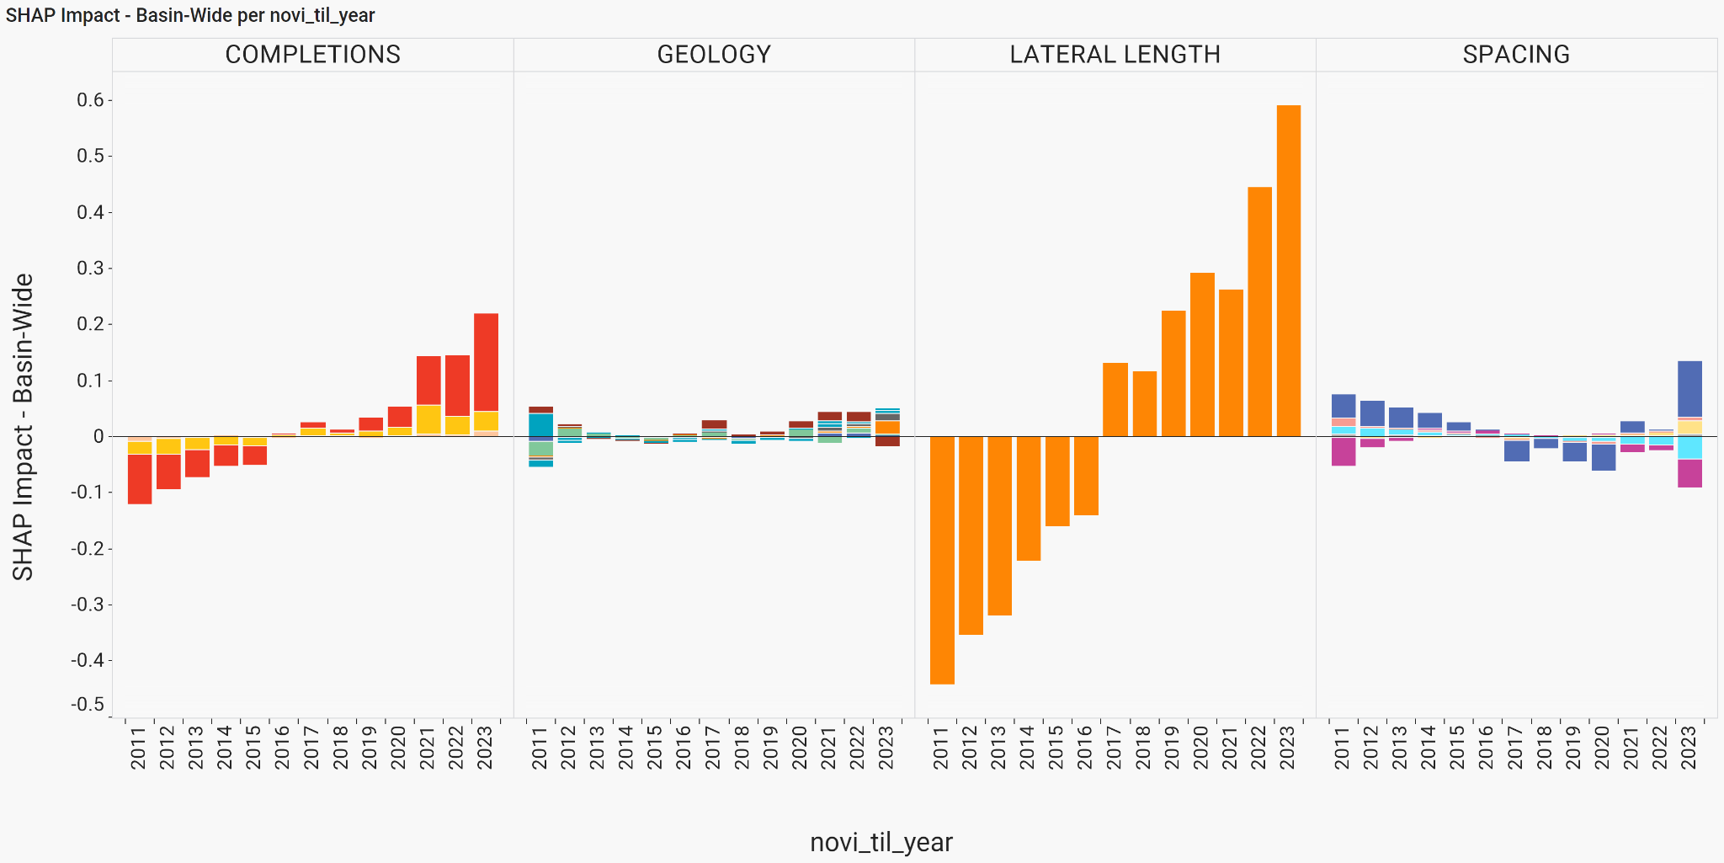
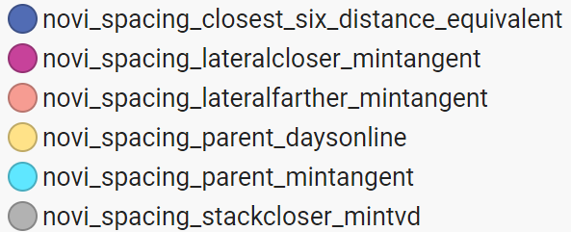
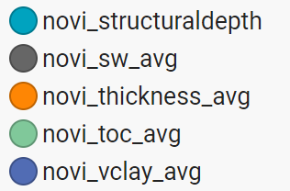
PRODUCTION DRIVERS OVER TIME - DJ
Lateral Length biggest driver over last decade; still improving
Spacing negative impact has moderated since 2020
Completions impact continues to increase; step change in 2021
Geology impact relatively consistent each year; no major change in rock quality drilled
Year of first production

Slide 30
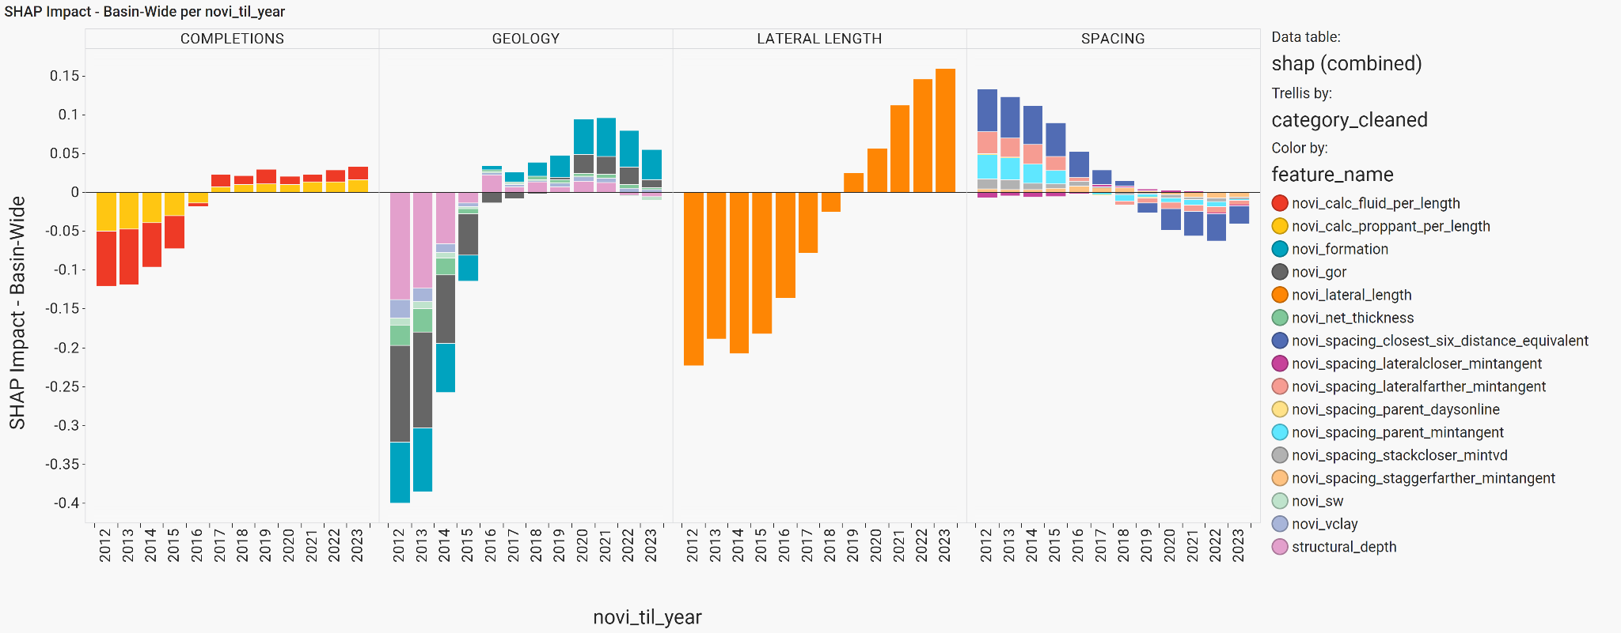
PRODUCTION DRIVERS OVER TIME - MIDLAND
Lateral length gains continue through 2023
Spacing & parent-child huge negative driver since early days
2020-2021:
serious high-grading
2012-2017: big improvement in completions impact
2012-2017: major improvement in rock quality as operators move focus from southeastern to northwestern Midland
Year of first production

Slide 31
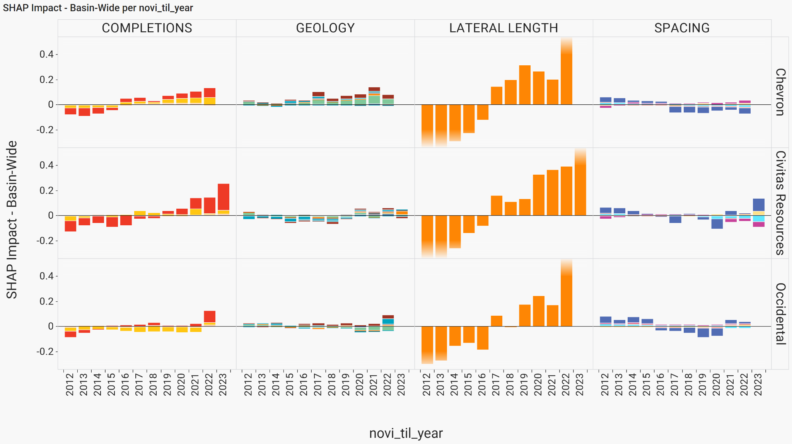
PRODUCTION DRIVERS OVER TIME - DJ BIG OPERATORS
Year of first production
Wells by current operator, not original

Slide 32
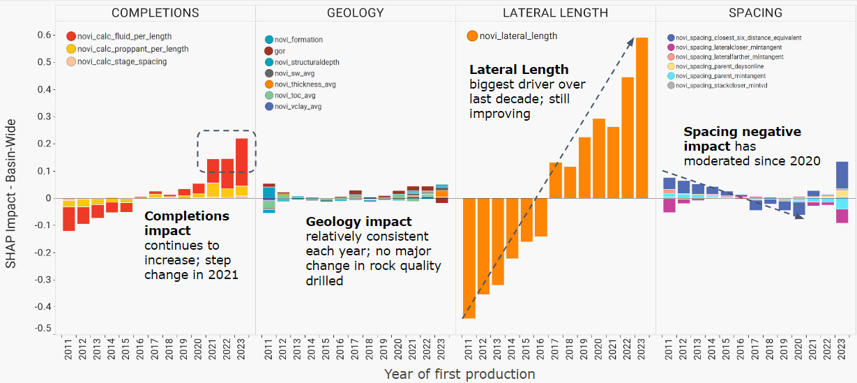
CONCLUSIONS
Well performance has been holding strong in the DJ, compared to the faltering in other plays.
A combination of longer laterals, more intense completions (especially fluid/ft), and wider interwell spacing have driven this trend.
In comparison to the Permian, the DJ saw less high-grading in 2020-201 and a larger impact of completions design post-2017.
Operator consolidation has been taking place during this period of innovation; this suggests well performance in other basins may also hold steady or improve as they consolidate.

Slide 33
Thanks!
Feel free to reach out any time: tcross@novilabs.com
or find me on LinkedIn

Slide 34
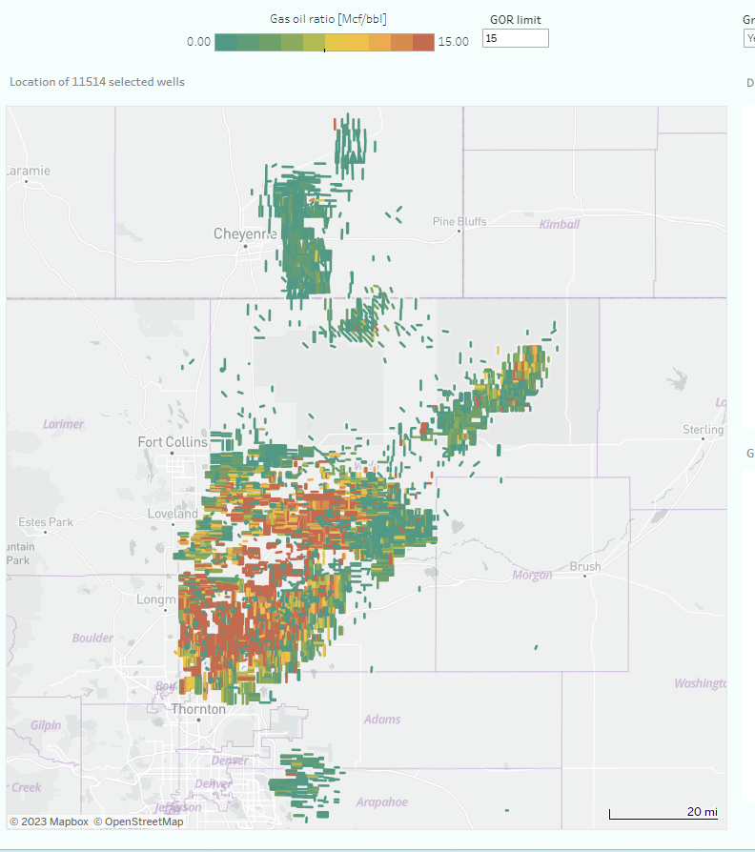
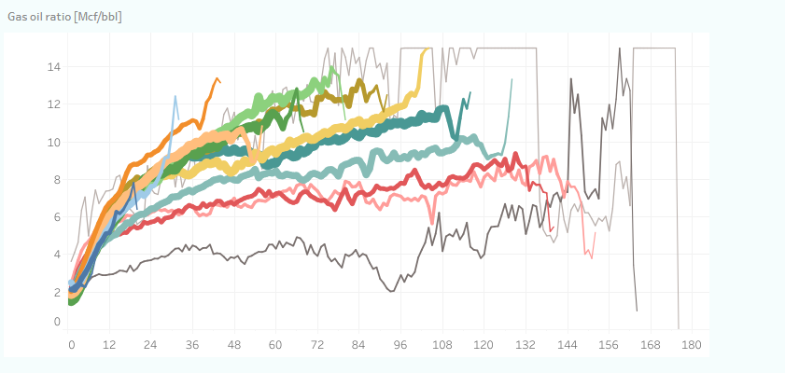
GAS OIL RATIO :: DJ BASIN

Slide 35
MODEL ERRORS - DJ & MIDLAND

Slide 36
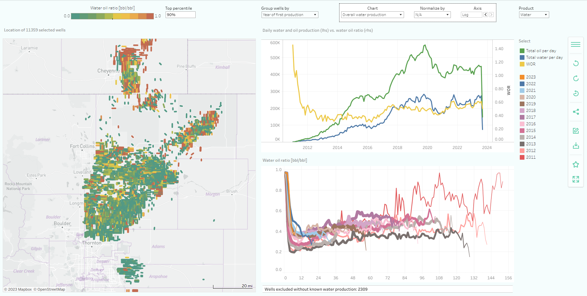
WOR - DJ BASIN

