Slide 1

Utilizing Cloud Technologies to Transform Oil & Gas Data Operations
Mindy Spellman – Senior Director of Data & Analytics
Matthew Mauch – Data Engineer

Slide 2
Agenda
Moving from on-prem to the cloud for data warehousing and analytics
The modern cloud toolkit
Medallion data architecture
Advantages of Databricks
Alerts, Agents and AI/ML uses
Q/A

Slide 3

Why Change? The On-Prem Data Challenge
• Siloed and inconsistent data across operations
• Limited scalability for M&A activity
• Increasing job run times which causes downstream performance issues
• Slow analytics and data gathering
• High maintenance costs and infrastructure overhead
• Data quality tracking and alerting functionality
• Hard to capture data lineage and source of truth

Slide 4

Advantages of Cloud Technologies
Enables validation to ensure data consistency across multiple system and business domains
Real-time scalability with cloud computing allowing for faster analytics and data ingestion
Cost efficiency – pay for what you use
Robust lineage allowing for effective data quality and application integrations
Version history available at the table level
Unified platform for Data Engineering, AI, Science, and Analytics
Notes:
-no more blocking, less downstream issues, timely loading of data in the face inconsistent data availability

Slide 5



Examples of the Cloud Toolkit
• Databricks – Unified lakehouse for analytics
• dbt – Data transformations and version control
• Dagster – Orchestration and data pipeline management
• Terraform – Infrastructure as code
• Elementary – Data quality and observability
• GitHub – CI/CD and version control
• Azure – Cloud hosting and identity management
• Claude – LLM to help understand and generate code/text

Slide 6
dbt, Elementary, Dagster
dbt: Data transformation and quality
Version control with GitHub integration
Utilizes data warehouse compute to compile code, determine lineage, and run models in appropriate order
Built in tests for data quality
Elementary: Data quality
Numerous built in data quality and freshness tests
Custom test building available
Built in data quality dashboard (more useful for engineers than business units)
All test results stored in data table
Dagster: Orchestration
Declarative automation (sensors)
Additional lineage tracking

Slide 7
Terraform, GitHub, Claude
Terraform: infrastructure as code
GitHub integration
Helps with automation and maintaining consistency in our infrastructure
GitHub: CI/CD and version control
Easily link issues with pull requests for documentation
Complete file history
Many integrations
Including GitHub Actions with Claude
Enterprise version allows for enforced rules on pull requests (GitHub Actions, reviews, formatting etc)
Claude
Using in GitHub actions on our pull requests
Identify models not following our described rules for tags
Identify downstream impacts/errors from changes in a pull request

Slide 8
Databricks/Azure
Many O&G companies are Microsoft shops -> we use Azure as our cloud host
Easy identity integrations
Unified platform
Lakehouse, lineage, ML/AI, dashboarding, and data quality (new features on the way) all in one spot
Table version history
Serverless compute
No spin up time
Autoscaling for better performance
Cost savings via minimizing idle time

Slide 9

Impact and Results
Improved data trust and visibility across business domains
Faster data pipelines and integrations means faster analytics and BI tool usage
Empowered teams with self-service analytics
Alerts and Genie
Scalable foundation ready for Agents, AI, and ML expansion

Slide 10
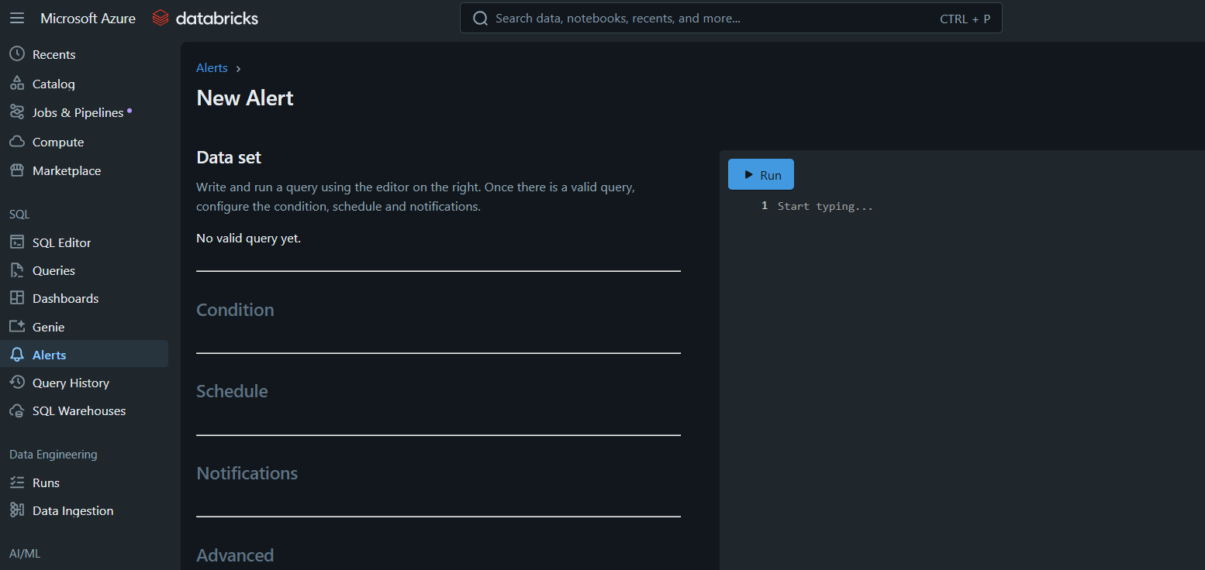
Alerts in Databricks
Real-time alerts for job failures, performance issues, and data exceptions

Slide 11

Genie in Databricks
Genie provides AI-driven troubleshooting and root-cause suggestions
Allows more users to create their own queries, reports, dashboards and notebooks
Genie Rooms which require setup, but allows for a more curated sample queries to help interpret user questions into SQL
Conversational context that keeps history and acts as a chat bot
Can help to generate tables and visualizations

Slide 12
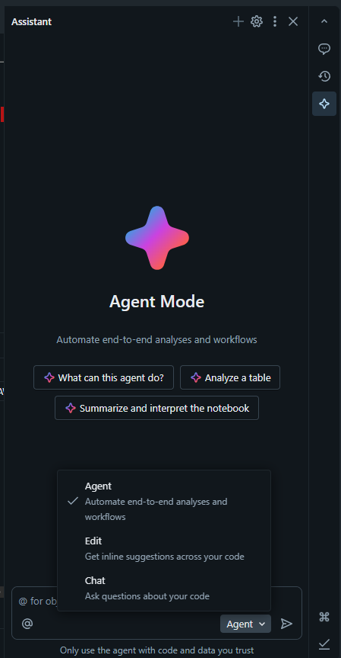
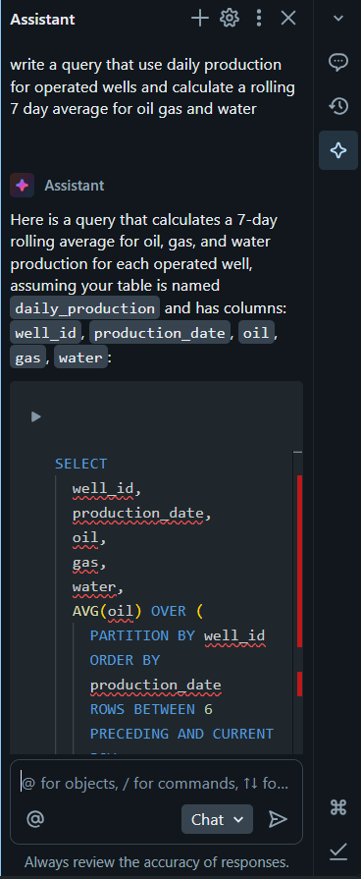

Slide 13
Agent and AI/ML
CI Agent use cases
Check and ensure code is present and report compliance issues
SQL model tag analysis to check that tags are setup appropriately and provides suggestions based on other models
SQL impact analysis that will report on breaking changes and which models are impacted
Evaluate intermittent error messages and retry loads that have failed and don’t need a human to resolve
AI/ML Options
ML: Build ML pipelines, train/deploy models, AutoML (databricks uses PySpark)
GenAI: Use Mosaic AI suite for custom copilots/chatbots, use opensource LLM’s, semi/unstructured data

Slide 14

Thank you to SPE for allowing us to do this talk!
Questions?

